Slide 1
TOGAF 9.1 Introduction
Padmajeet Mhaske

Slide 2
What is Enterprise? What is Architecture?

Slide 3
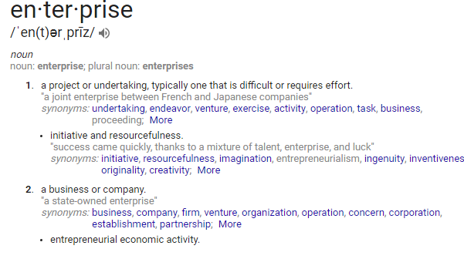
What is Enterprise?

Slide 4
What is Enterprise?
TOGAF 9.1:
The highest level (typically) of description of an organization and typically covers all missions
and functions. An enterprise will often span multiple organizations.

Slide 5
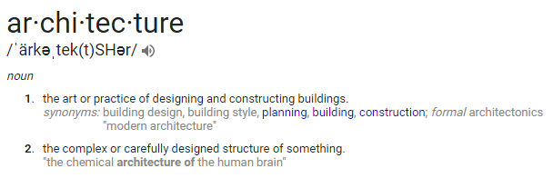
What is Architecture?

Slide 6
What is Architecture?
TOGAF 9.1:
A formal description of a system, or a detailed plan of the system at component level, to guide its implementation (source: ISO/IEC 42010: 2007).
The structure of components, their inter-relationships, and the principles and guidelines governing their design and evolution over time.

Slide 7
What is Enterprise Architecture?
-Wikipedia
"a well-defined practice for conducting enterprise analysis, design, planning, and implementation, using a comprehensive approach at all times, for the successful development and execution of strategy. Enterprise architecture applies architecture principles and practices to guide organizations through the business, information, process, and technology changes necessary to execute their strategies. These practices utilize the various aspects of an enterprise to identify, motivate, and achieve these changes."

Slide 8

Why we need Enterprise Architecture?

Slide 9
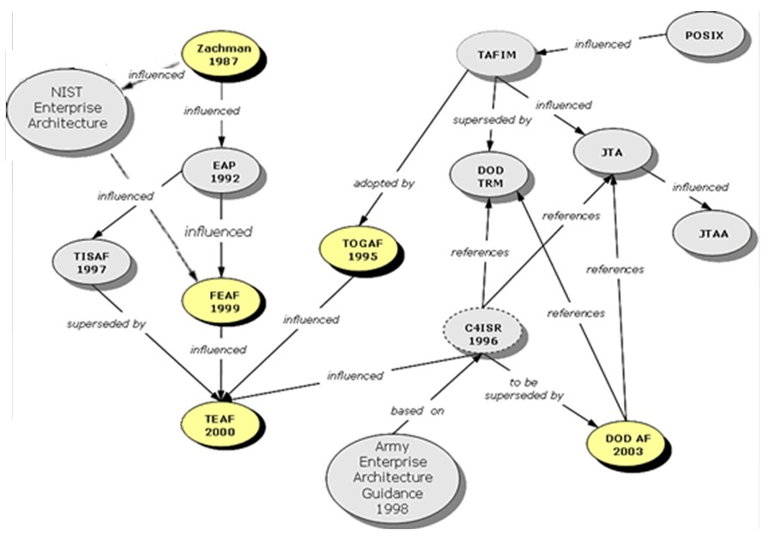
What is Enterprise Architecture Framework?

Slide 10
What is Enterprise Architecture Framework?
An enterprise architecture framework (EA framework) defines how to create and use an enterprise architecture.
An architecture framework provides principles and practices for creating and using the architecture description of a system.
It structures architects' thinking by dividing the architecture description into domains, layers, or views, and offers models - typically matrices and diagrams - for documenting each view.
This allows for making systemic design decisions on all the components of the system and making long-term decisions around new design requirements, sustainability, and support.

Slide 11
What is TOGAF 9.1

Slide 12
What is Architecture?

Slide 13
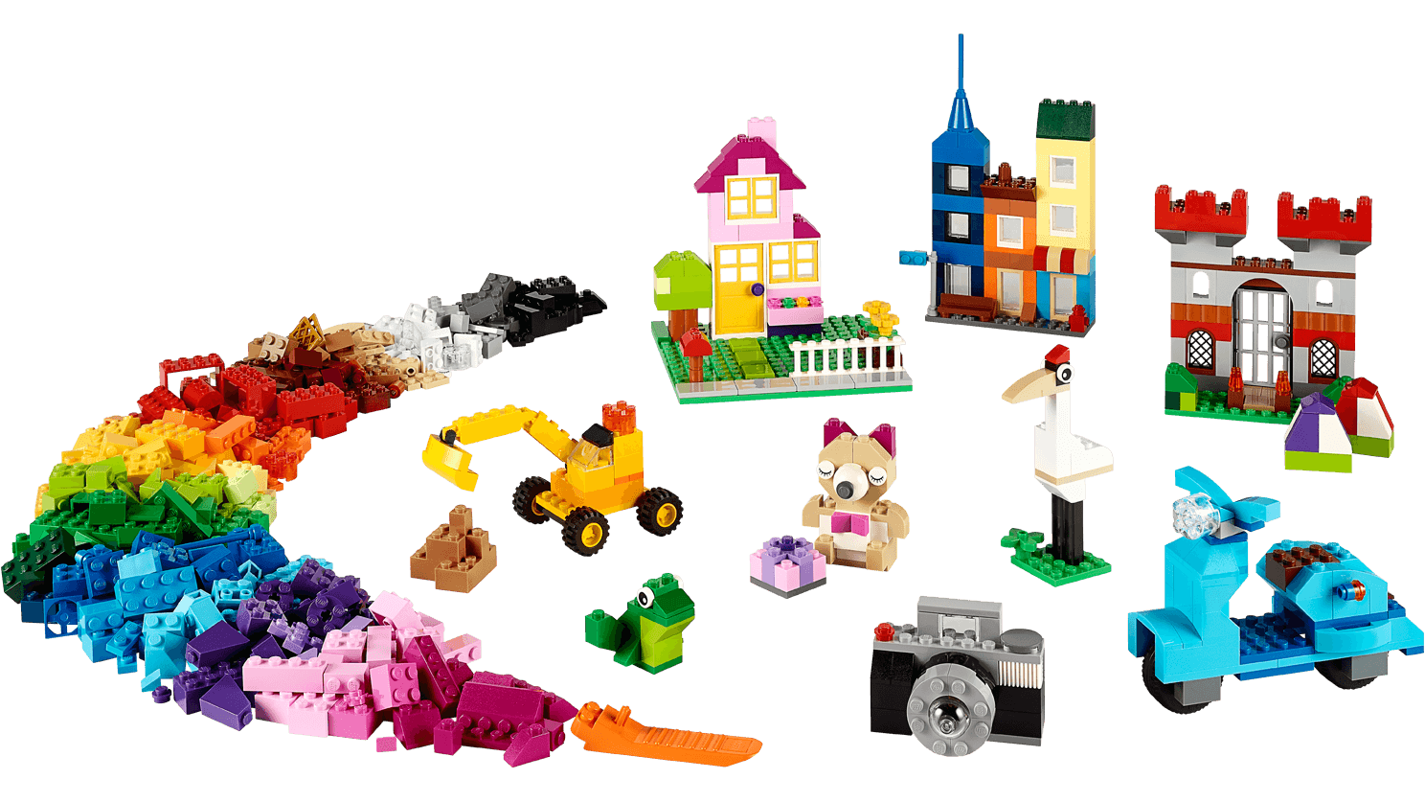
Blocks Game
Enterprise Architecture as a Building Block game

Slide 14
Modular Structure
Content Framework
Extended Guidance
Architectural Styles
Additional ADM detail
TOGAF Capability Framework
Architecture Capability Framework (Part VII)
Business Vision and Drivers
Informs the capability
Sets targets, KPIs, budgets for architecture roles
Business Capabilities
Ensures Realization
of Business Vision
Drives need for Architecture Capability maturity
TOGAF ADM &
Content Framework
Business needs feed into method
Architecture Development Method (Part II)
Delivers new business solutions
ADM Guidelines & Techniques (Part III)
Refines
Understanding
Architecture Content Framework (Part IV)
TOGAF Enterprise Continuum & Tools
Enterprise Continuum & Tools (Part V)
Informs the Business
of the current state
Operational changes cause updates
TOGAF Reference Models (Part VI)

Slide 15
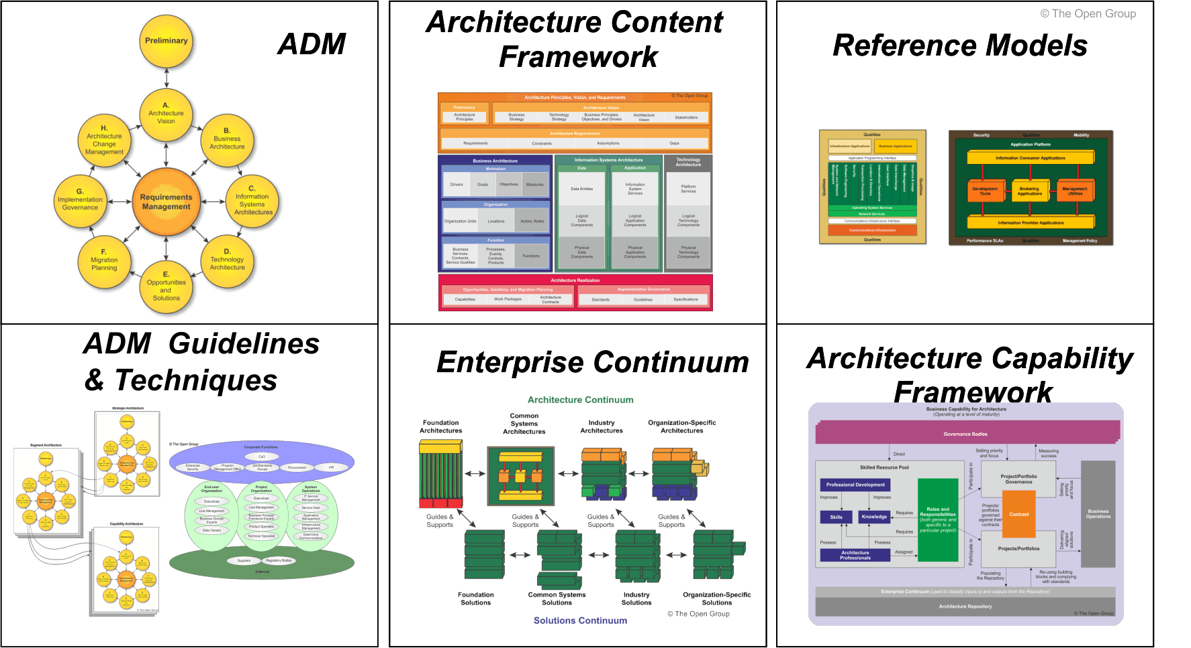
TOGAF® 9 Components

Slide 16
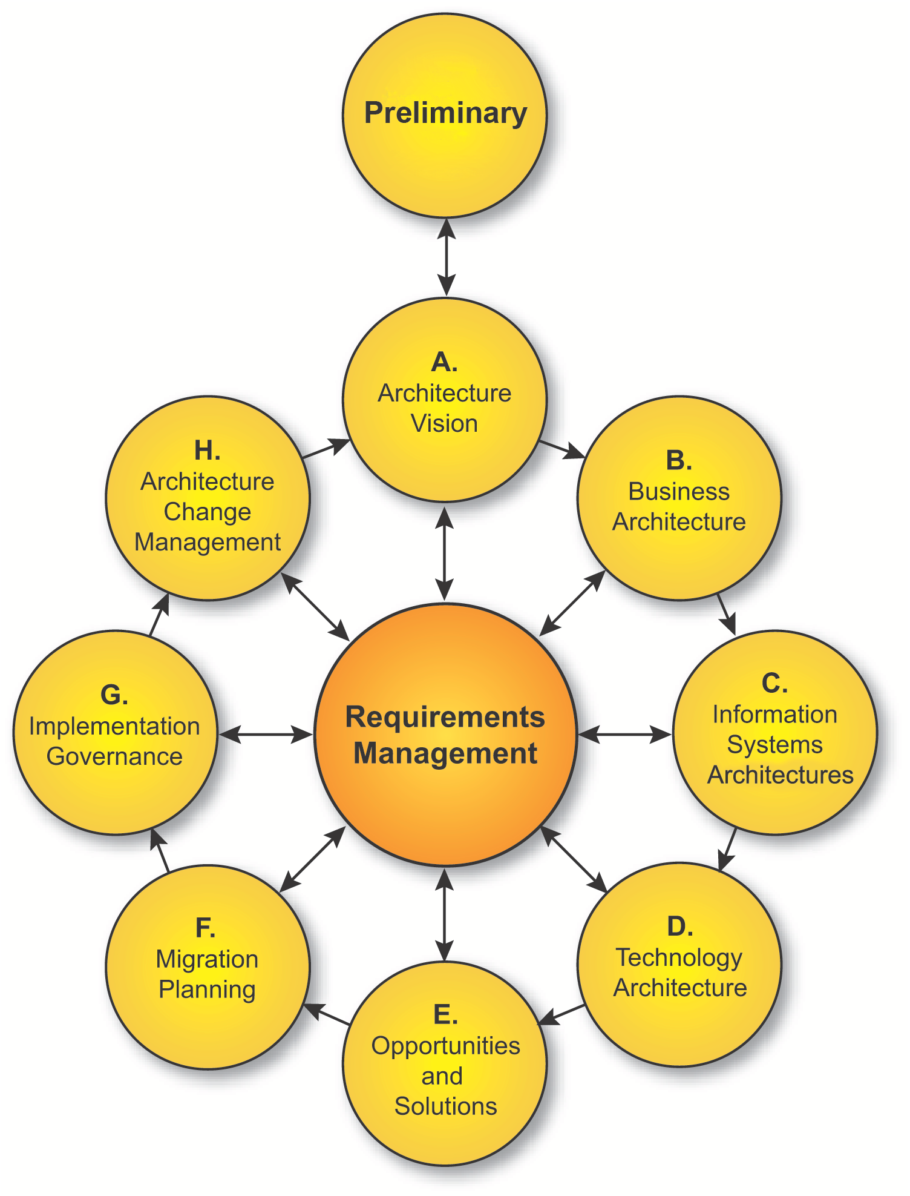
The Architecture Development Method
The core of TOGAF
A proven way of developing an architecture
Specifically designed to address business requirements
An iterative method
A set of architecture views to ensure that a complex set of requirements are adequately addressed

Slide 17
ADM – Basic Principles
An iterative method, over the whole process, between phases and within phases
Each iteration = new decisions:
Enterprise coverage
Level of detail
Time horizon
Architecture asset re-use:
previous ADM iterations
other frameworks, system models, industry models,…
Decisions based on:
Competence / resource availability
Value accruing to the enterprise.

Slide 18
ADM Phases
Prepare the organization for a successful architecture project
Set the scope, constraints and expectations for a TOGAF project; create the Architecture Vision;
validate the business context; create the Statement of Architecture Work
Provide continual monitoring and a change management process to ensure that the architecture responds to the needs of the enterprise
Develop Business Architecture
Develop baseline and target architectures and
analyze the gaps
Provide architectural oversight for the implementation; ensure that the implementation project conforms to the architecture
Develop Information Systems Architectures
Develop baseline and target architectures and
analyze the gaps
Analyze costs, benefits and risks; develop detailed Implementation and Migration Plan
Develop Technology Architecture
Develop baseline and target architectures and
analyze the gaps
Ensure that every stage of a TOGAF project is based on and validates business requirements
Perform initial implementation planning; identify major implementation projects

Slide 19
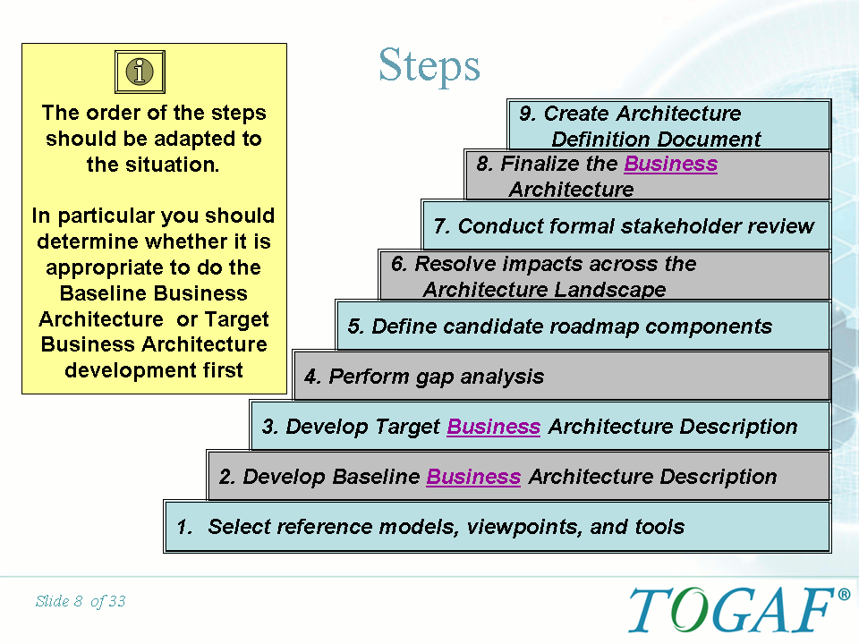
ADM Phase Steps Example

Slide 20
ADM Guidelines and Techniques
A set of guidelines and techniques to support the application of the ADM
The guidelines help to adapt the ADM to deal with different scenarios, including different process styles (e.g. the use of iteration) and also specific requirements (e.g. security).
The techniques support specific tasks within the ADM (e.g. defining principles, business scenarios, gap analysis, migration planning, risk management, etc).

Slide 21
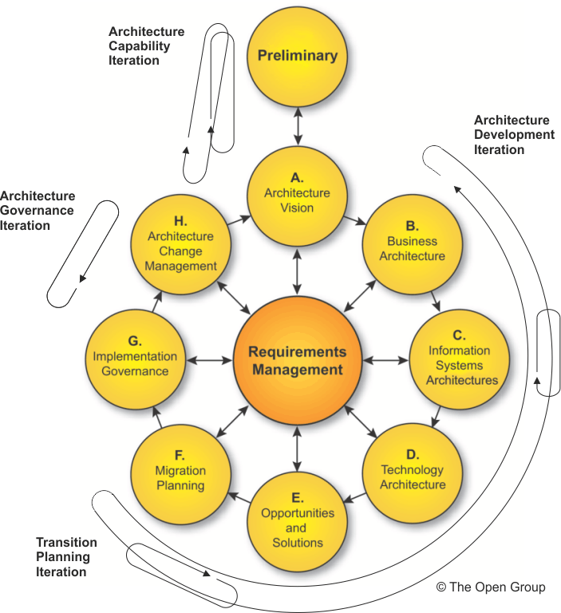
Applying Iteration to the ADM
Example Guideline

Slide 22
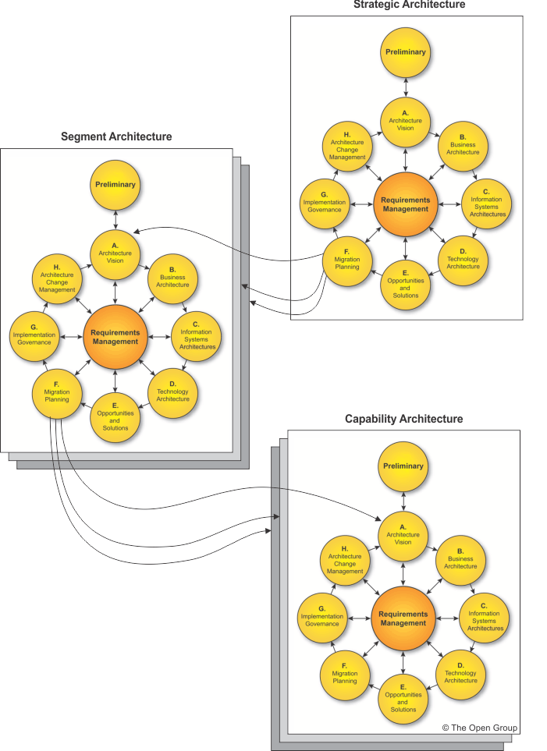
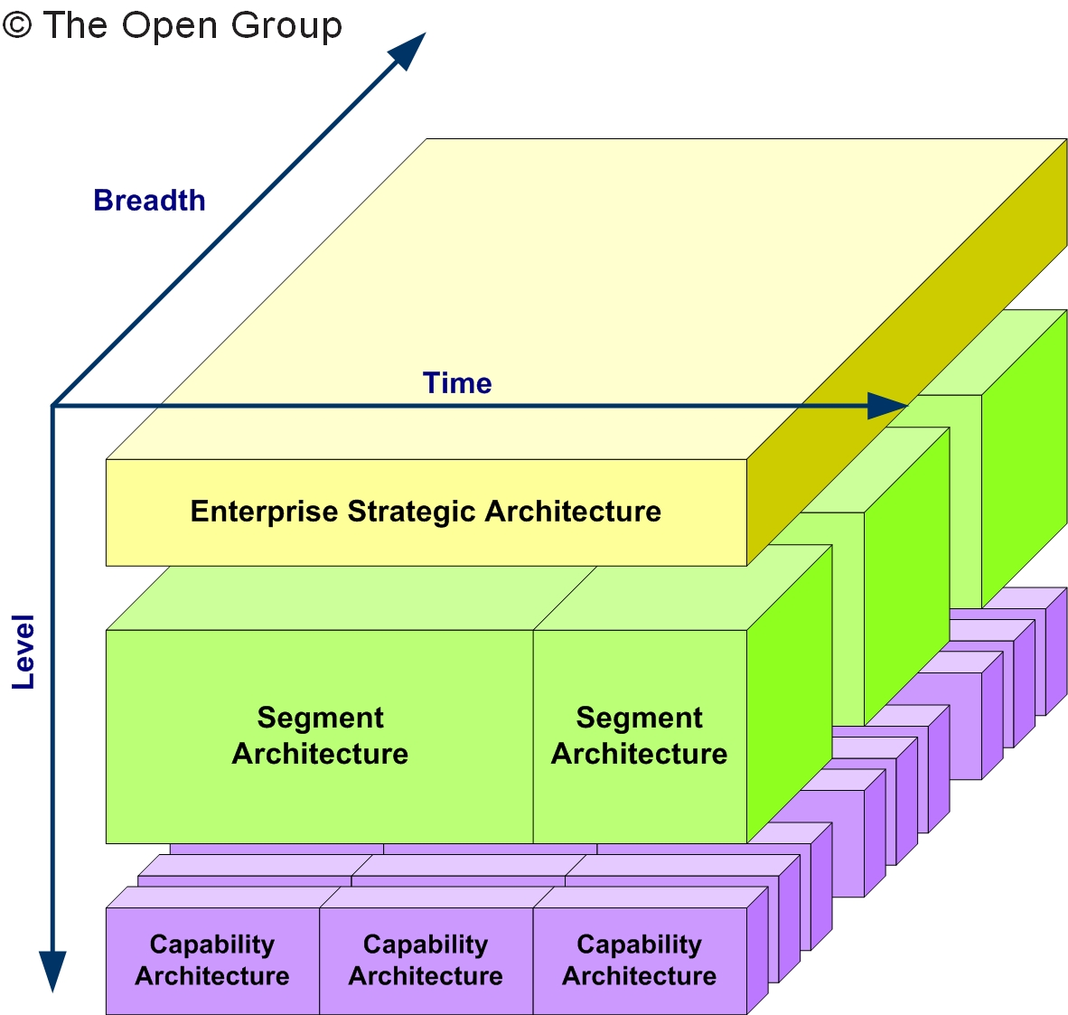
Applying the ADM - Across the Architecture Landscape
Example Guideline

Slide 23
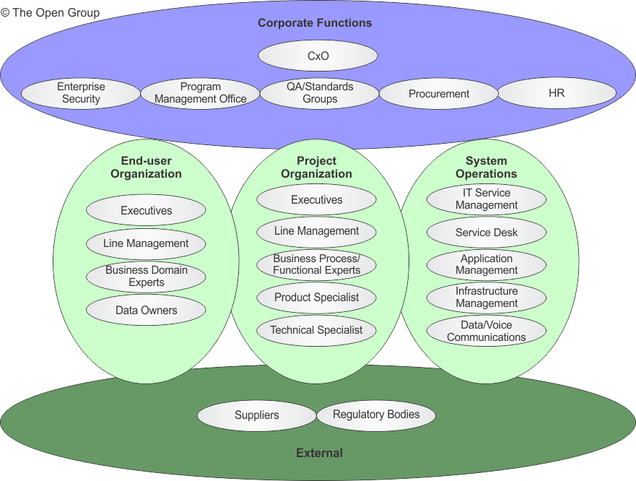
Categories of Stakeholder
Example Technique

Slide 24
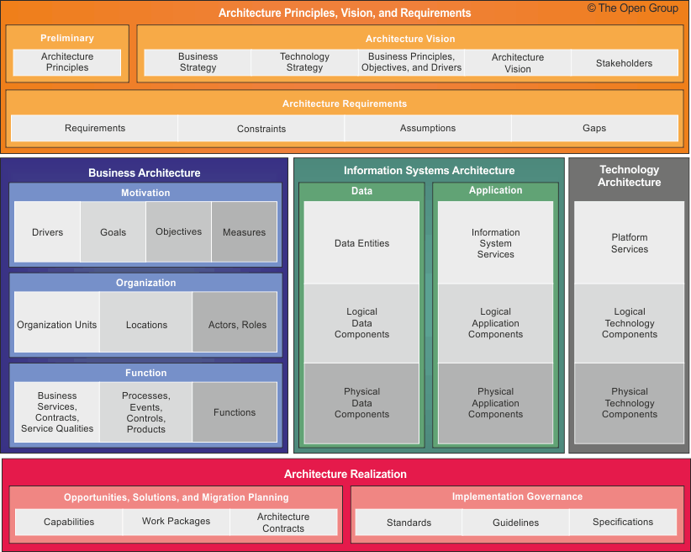
Architecture Content Framework
Provides a detailed model of architectural work products, including Deliverables, Artifacts within deliverables, and the Architecture Building Blocks (ABBs) that deliverables represent.
It drives for greater consistency in the outputs of TOGAF
It provides a comprehensive checklist of architecture outputs
It promotes better integration of work products
It provides a detailed open standard for how architectures should be described
It includes a detailed metamodel

Slide 25
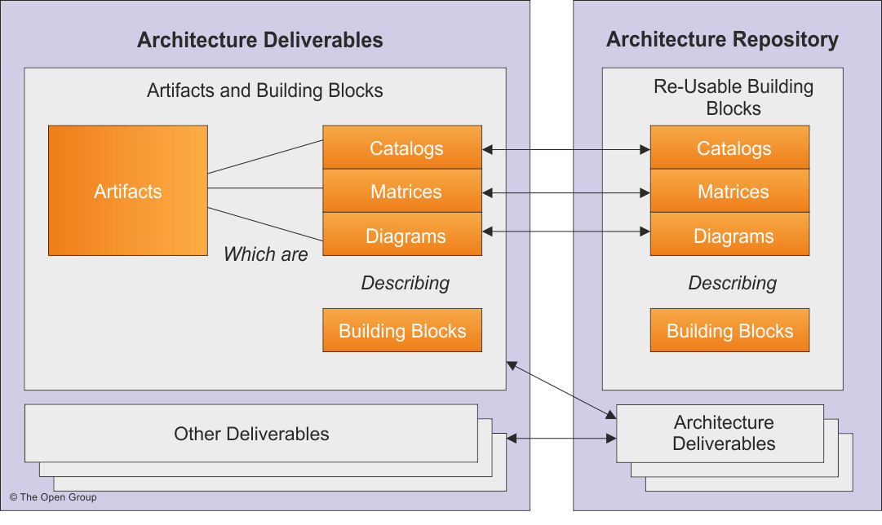
Deliverables, Artifacts and Building Blocks

Slide 26
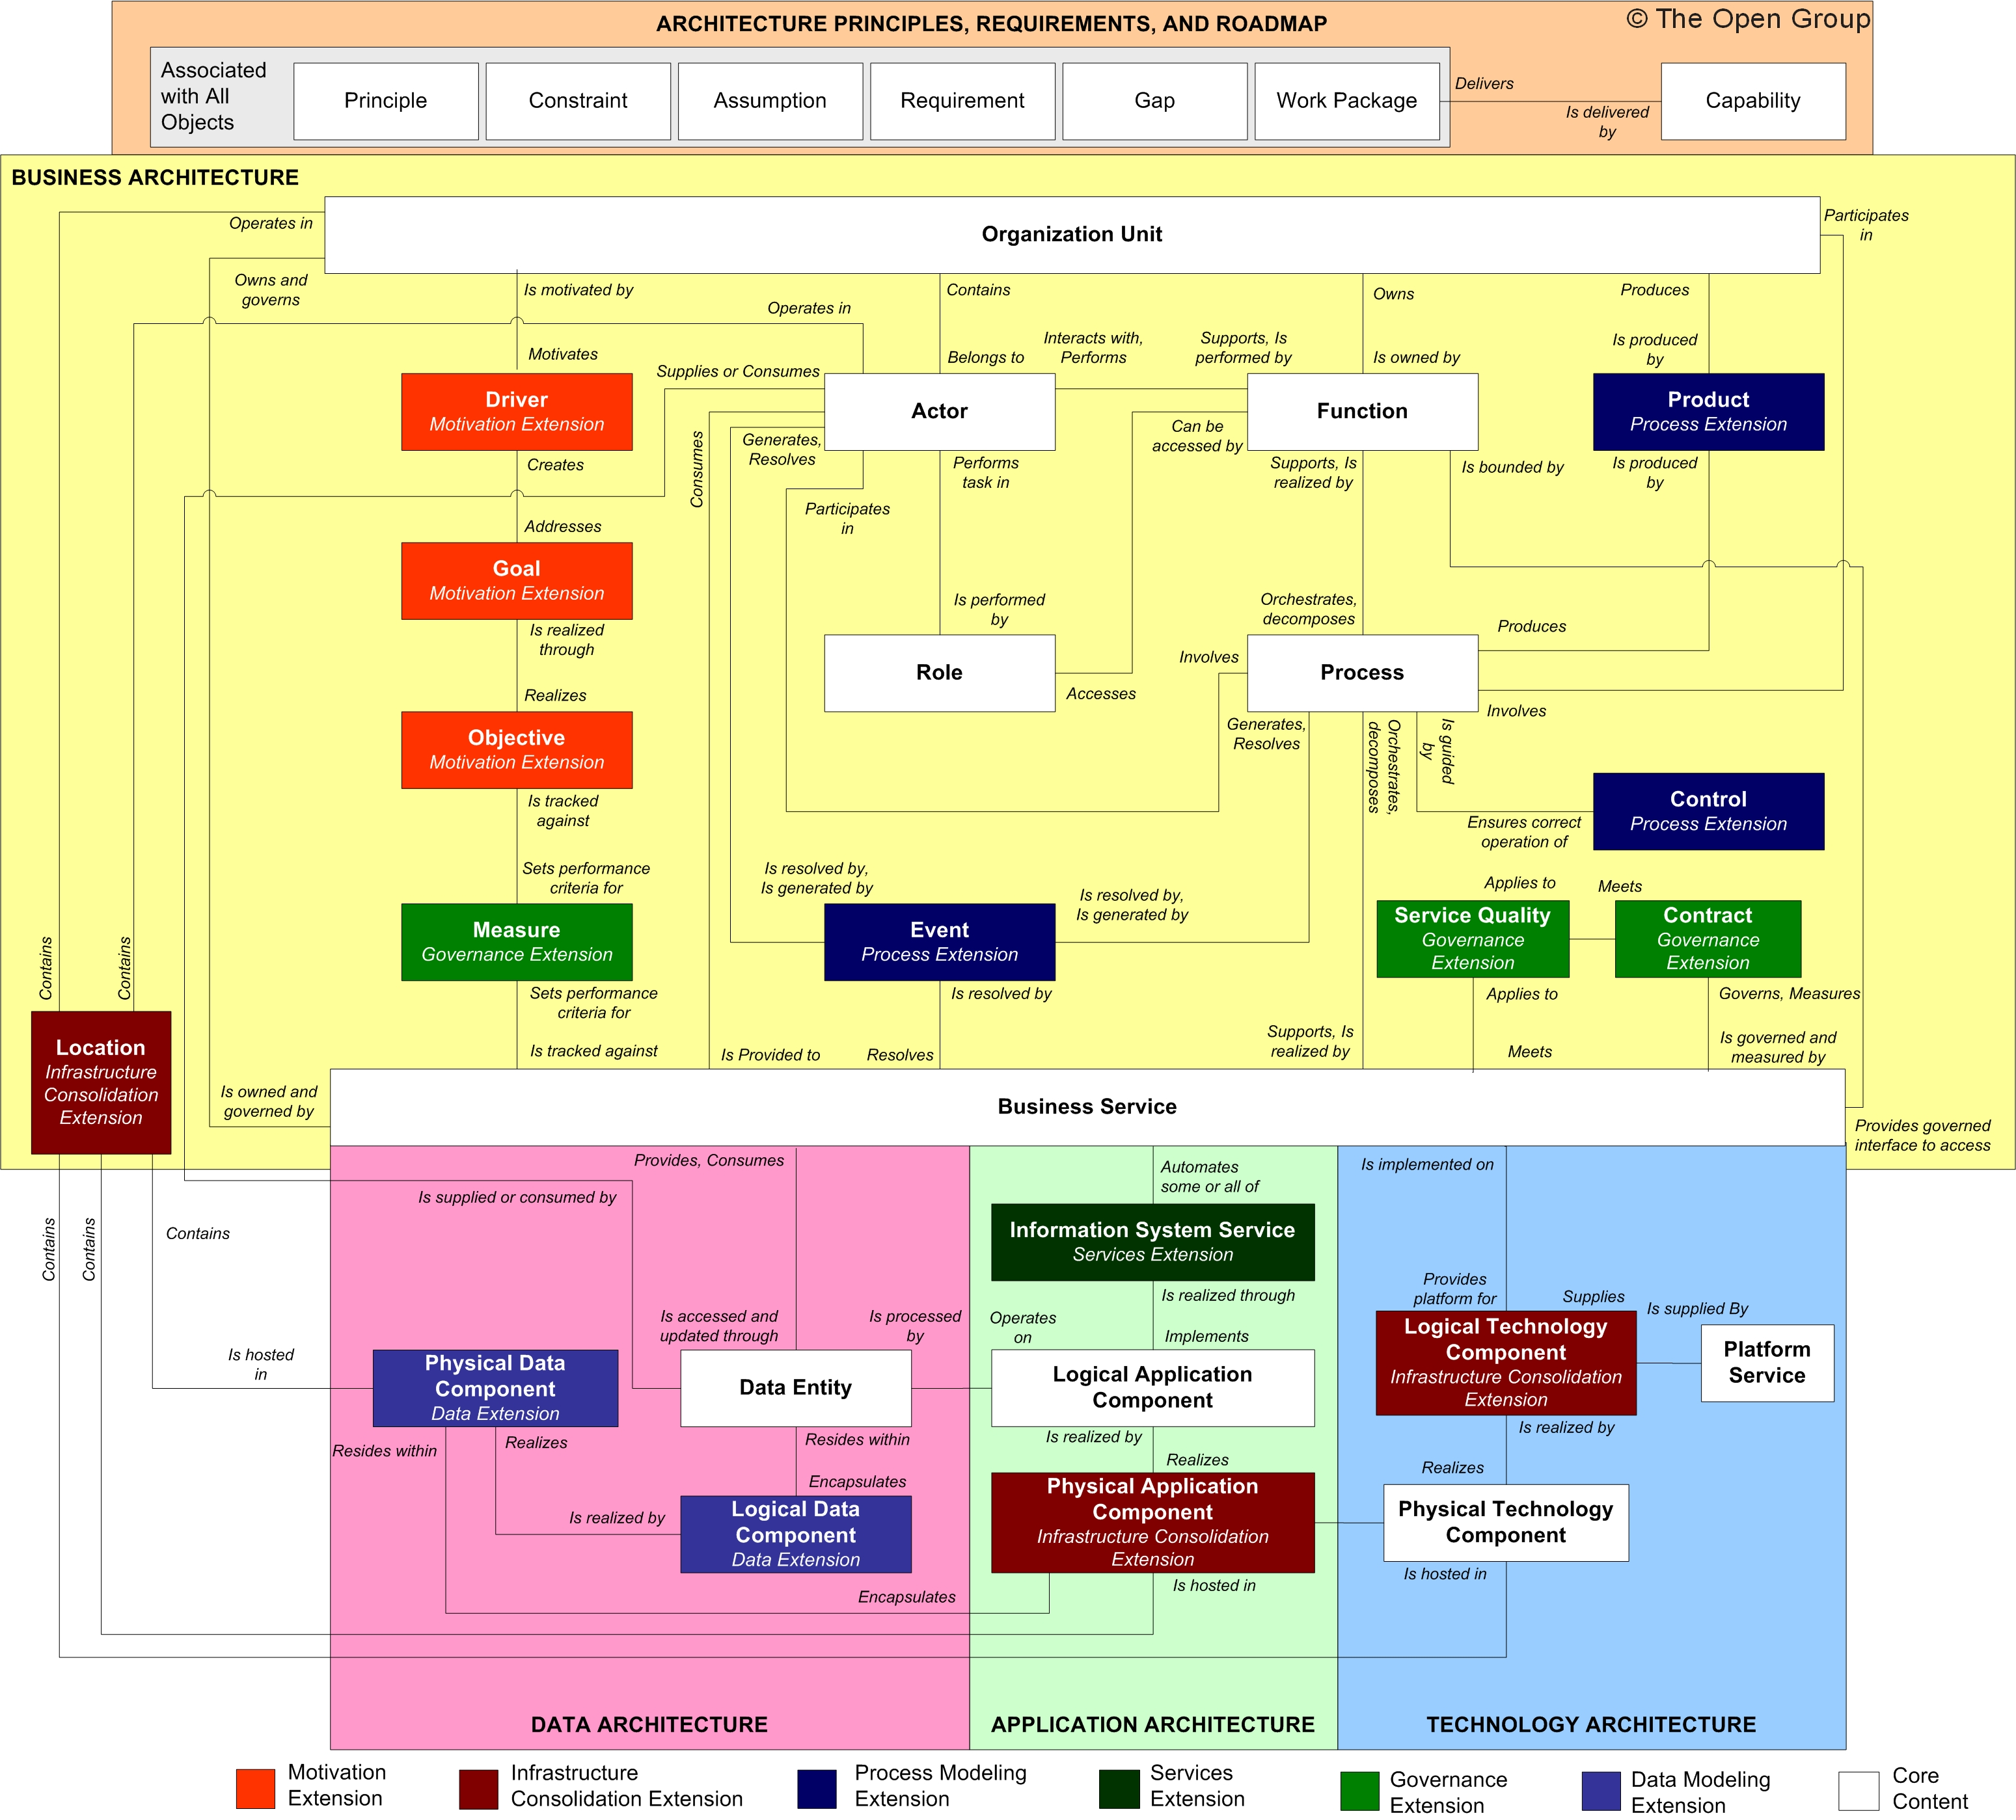
Full Content Metamodel with Relationships

Slide 27
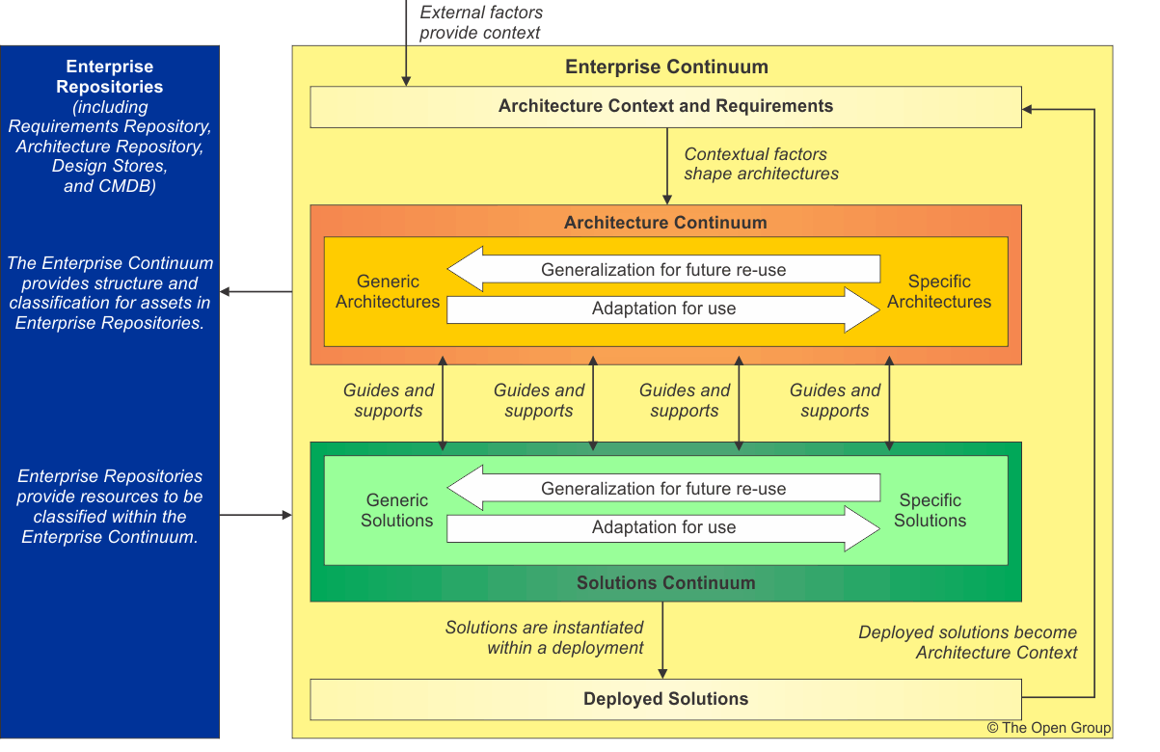
The Enterprise Continuum

Slide 28
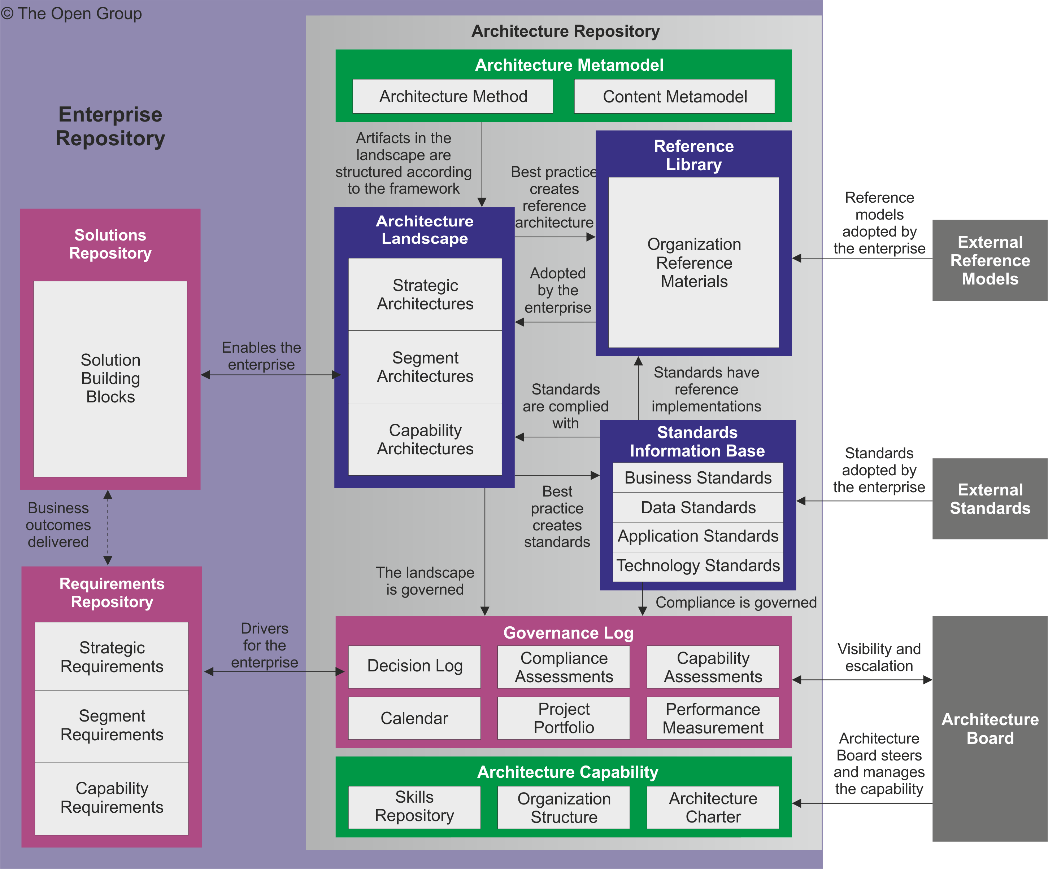
Architecture Repository

Slide 29
TOGAF® Reference Models
Two Reference Models are provided
The TOGAF Technical Reference Model (TRM)
A Foundation Architecture
A model and a taxonomy of generic platform services
The Integrated Information Infrastructure Model (III-RM).
A model for business applications and infrastructure applications
Specifically aimed to support the vision of Boundaryless Information Flow™

Slide 30
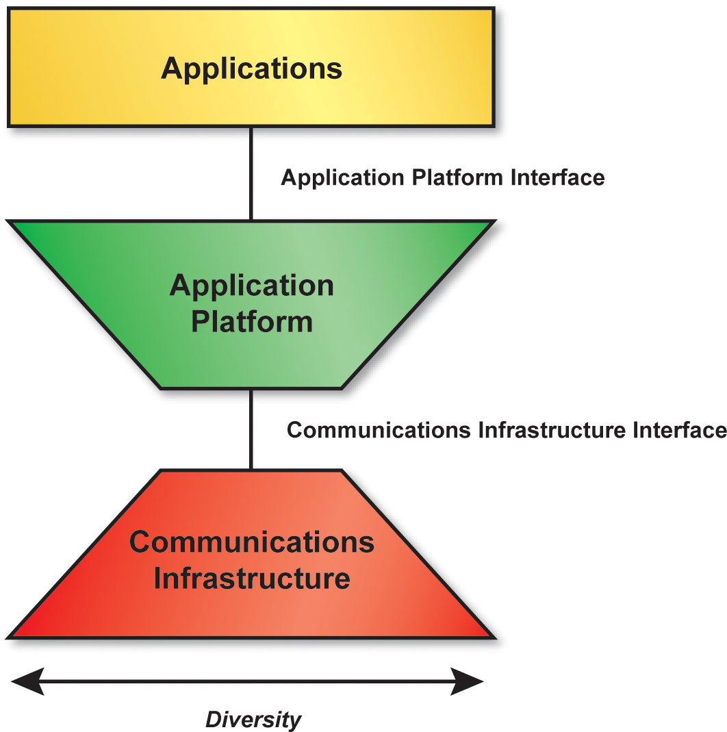
High-Level TRM

Slide 31
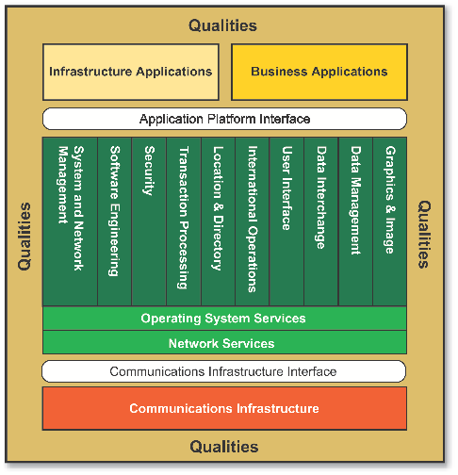
Detailed TRM

Slide 32
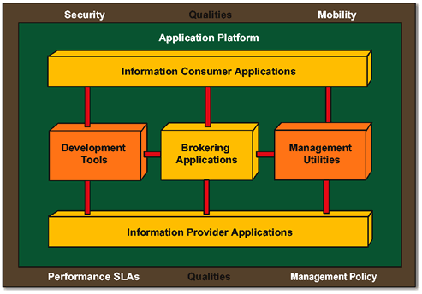
The Integrated Information Infrastructure Reference Model (III-RM)

Slide 33
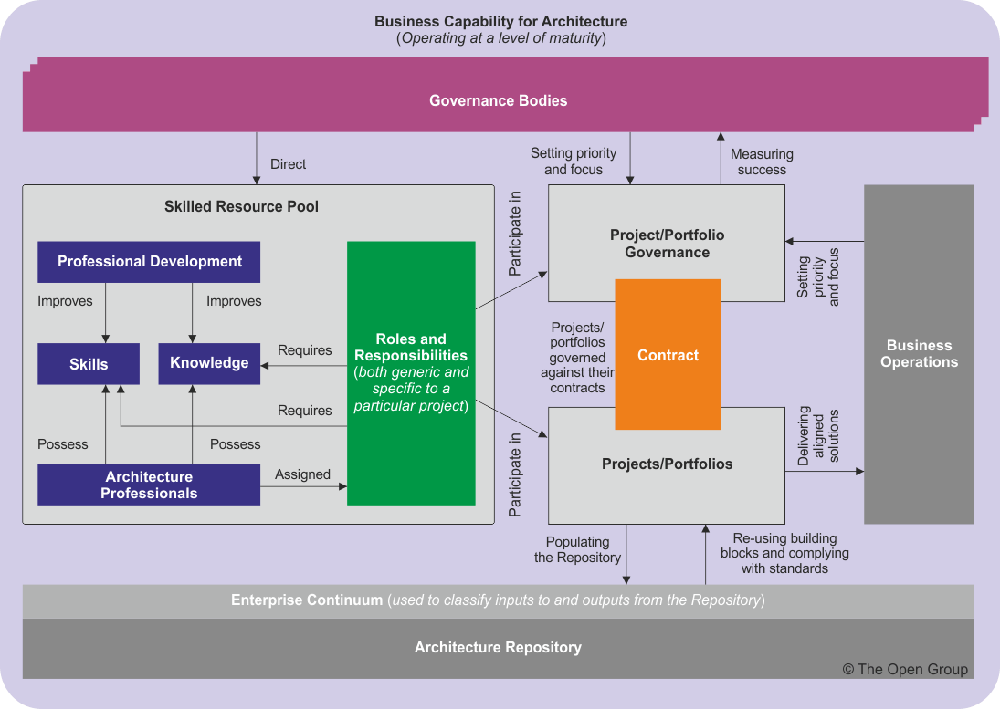
Capability Framework

Slide 34
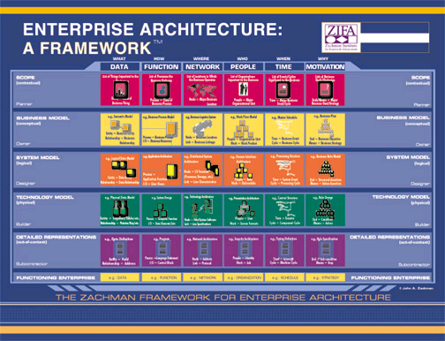

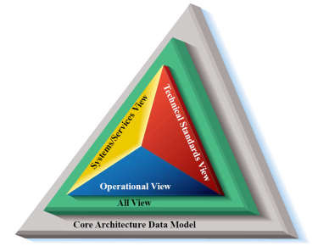
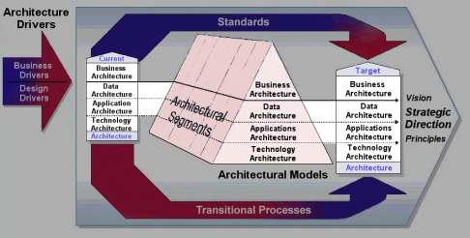
Stand-alone or Complementary
Zachman Framework
Support or
Guidance
DoD Architecture Framework
TOGAF 9
Other Frameworks
Federal Enterprise Architecture Framework

Slide 35

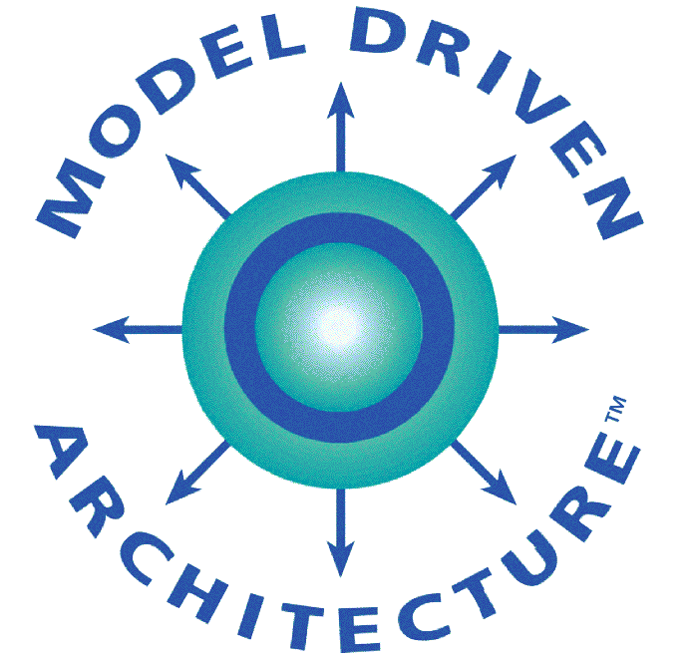
Complementary
ITIL
Framework, method and resources
IT Service Management
Best Practice
TOGAF 9
COBIT
Modeling languages and notation
Governance and control

Slide 36
Value of TOGAF® Certification
A globally recognized standard, backed by certification
Certified professionals
Demonstrable knowledge of TOGAF
Minimizes employers' hiring time and improves quality of hires
Vendors of TOGAF Certified Products or Services
Warrant conformance to the TOGAF product standard throughout the lifetime of certification
Customers who procure are assured of compliance
Certification credentials can readily be verified

Slide 37
TOGAF® Certification
Certification Level | Purpose
TOGAF 9 Foundation | To provide validation that the candidate has gained knowledge of the terminology and basic concepts of TOGAF 9 and understands the core principles of Enterprise Architecture and TOGAF
TOGAF 9 Certified | To provide validation that in addition to knowledge and comprehension, the candidate is able to analyze and apply knowledge of TOGAF

Slide 38
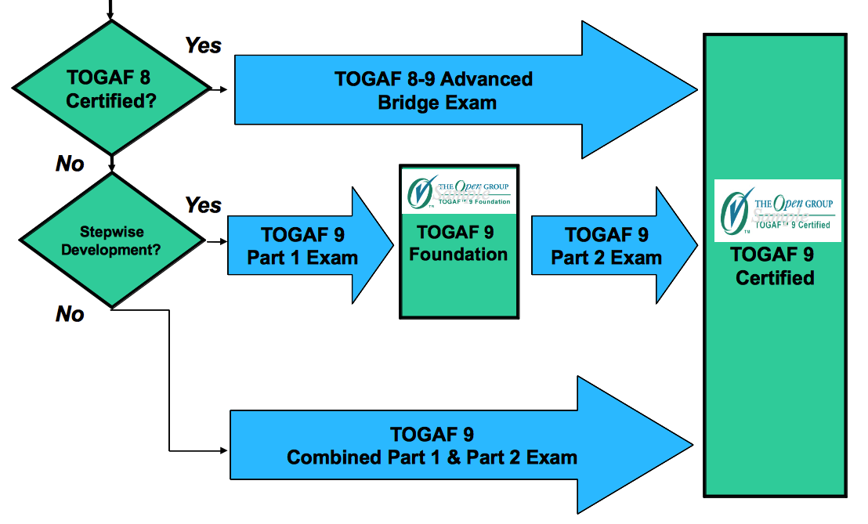
TOGAF® 9 Certification

Slide 39
Summery
TOGAF®, an Open Group Standard, is…
An effective, industry standard framework and method for enterprise architecture.
Complementary to, not competing with, other enterprise frameworks
A repository of best practice
Vendor, tool, and technology neutral
A framework and method for achieving the “Boundaryless Information Flow” vision

Slide 40


Thank You

Slide 41
Question??

